Slide 1
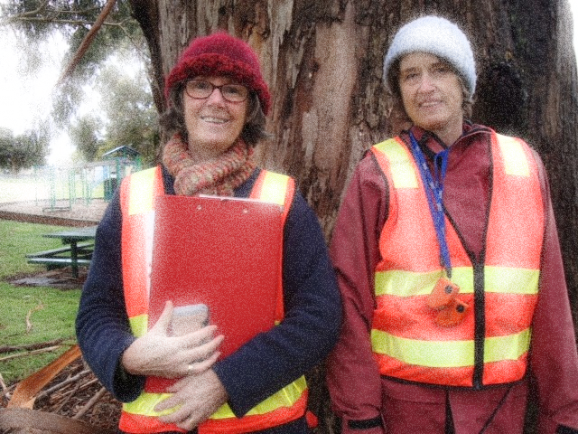
Volunteer Induction
Welcome and thank you for joining with Council to deliver services to the community as a volunteer.
This induction will introduce you to information and safety checks that will enhance your experience.
1

Slide 2
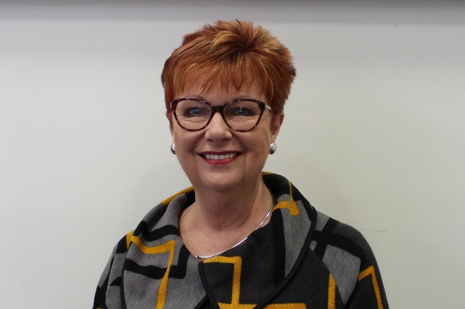
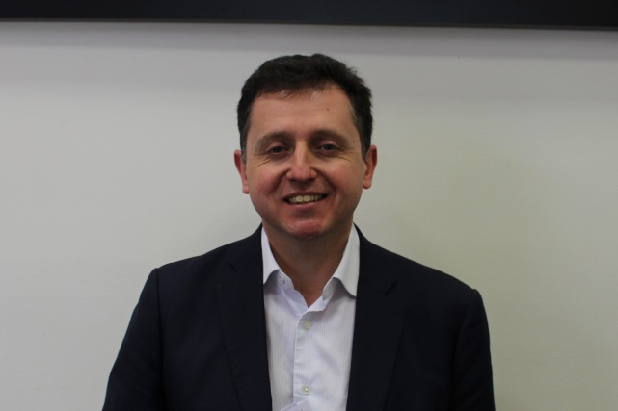
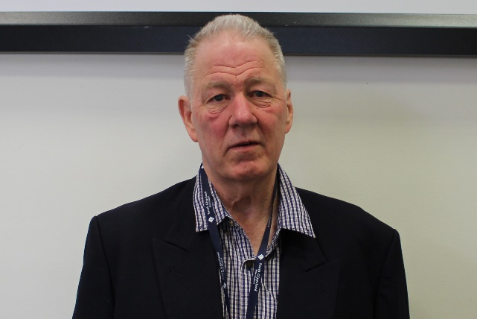
Welcome
South Gippsland Shire Council is led by three Administrators appointed in 2019. The Administrators make strategic decisions to guide the direction and activities of Council. If you would like to communicate with any of the Administrators you can get their contact details via Council’s website – www.southgippsland.vic.gov.au
Julie Eisenbise
Christian Zahra
Rick Brown
Notes:
First meeting attended by 13 halls four years ago – group decision to continue with establishing a collaborative support network. Now still regular quarterly meetings well attended. Always growing

Slide 3
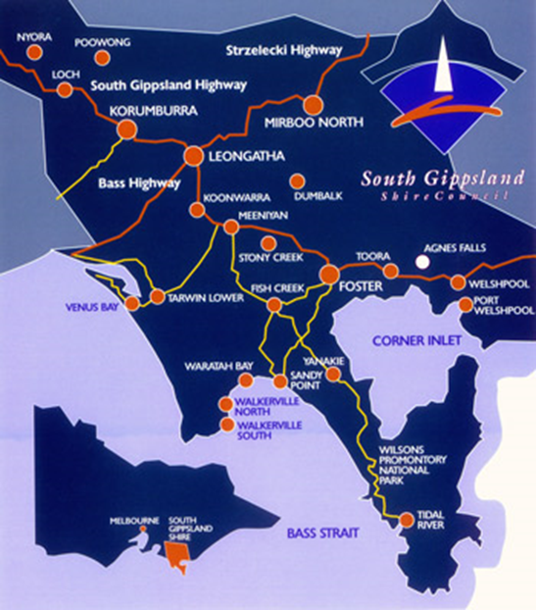
Facts about South Gippsland
The South Gippsland Shire
South Gippsland Shire Council was created on December 2, 1994 by the merging of the former Shires of Korumburra, Woorayl, Mirboo and South Gippsland.
The current population is over 28,000.
Area: 3,280sq km
Rate Income: $20,600,000
Rateable Properties: 17,785
Sealed Roads: 763km
Notes:
Shows the spread of Halls over the last 12 months who have attended or sent apologies for the network meetings

Slide 4
The Story of the Logo
The South Gippsland Shire logo launched in 1995
Symbolic design reflecting the sweeping landscape from the mountains to the sea.
The design can be interpreted in many ways. Viewers may see rolling hills, water coastline, the Prom lighthouse, a sailing boat
‘Come for the beauty, Stay for the lifestyle’ markets the region as a destination for tourism and as an invitation to relocate.
Notes:
Shows the spread of Halls over the last 12 months who have attended or sent apologies for the network meetings

Slide 5
The Role of A Volunteer
Volunteering is essential to healthy communities. It is volunteers who contribute to the fabric of our community through sports, caring for people in need, events, contributing to the running of facilities such as halls, venues, museums and galleries and more.
Did you know in South Gippsland:
29.3 percent of the population reported performing voluntary work, compared with 24.3 percent for Regional VIC. (Ref: 2016 Census)
The number of volunteers in South Gippsland increased by 440 people between 2011 and 2016
By partnering with Council you are part of a group of people making a difference in their community.
Notes:
Shows the spread of Halls over the last 12 months who have attended or sent apologies for the network meetings

Slide 6
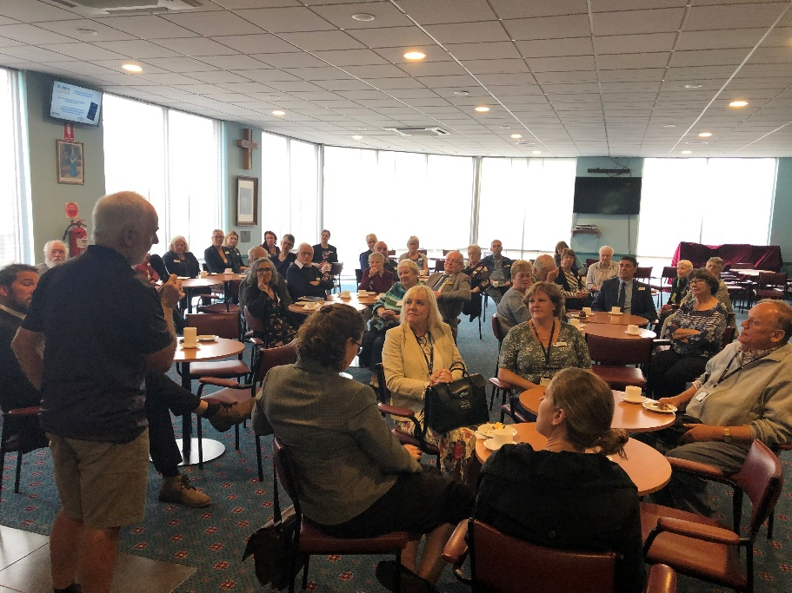
Volunteer Rights
Council recognises your rights as a volunteer which includes:
Information about Council
A clearly written job description
Be recognised as a valued team member
Knowing to whom you are accountable
Be supported and supervised in your role
A healthy and safe working environment
Be covered by Public Liability Insurance and Personal Accident Insurance
Freedom to say “no” if you feel you are being exploited
Being reimbursed for authorised out-of-pocket expenses
Being informed and consulted on matters which directly or indirectly affect you and your work
Being made aware of the grievance procedure within the organisation
Orientation and training
Notes:
First meeting attended by 13 halls four years ago – group decision to continue with establishing a collaborative support network. Now still regular quarterly meetings well attended. Always growing

Slide 7
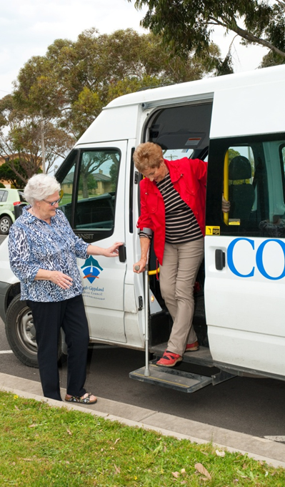
We ask that you…
Be reliable and accountable
Respect confidentiality
Carry out the specified tasks in the role description
Commit to the organisation
Undertake training as required
Request support when you need it
Advise Council of any changed circumstances e.g. the validity of licences, criminal conviction or medical issues or medication that will effect your performance
Give as much notice as possible if you intend to leave your role
Value and support other team members and volunteers
Carry out the work you have agreed to do responsibly and ethically.

Slide 8
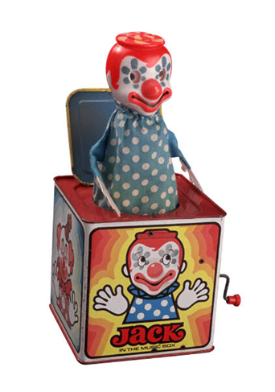
Sexual Harassment
South Gippsland Shire Council is committed to providing a workplace that is free from all discrimination, bullying and harassment, where all people are treated with dignity and respect.
Sexual harassment is against the law. “I was only joking” … is not a defence. Under the law, it is irrelevant whether or not the harassing behaviour was intended.
Sexual harassment includes any behaviour of a sexual nature that could be reasonably expected to make someone feel offended, humiliated or intimidated e.g.
An unwelcome sexual advance
Unwelcome comments about someone's sex life or physical appearance
Sexually offensive comments, stories or jokes
.
Notes:
More Halls involved in music and art events – working with Mary Sullivan, Council Arts Officer and Regional Arts Victoria

Slide 9
Anti Discrimination and Bullying
All employees, volunteers, councillors, customers and contractors are expected to comply with the SGSC Anti-discrimination, Bullying and Harassment Policy by modelling appropriate behaviour to promote a climate of respect.
Individuals have the responsibility to:
Treat each other fairly and with respect
Make others aware if someone’s behaviour is making you feel uncomfortable
Speak up if they observe inappropriate behaviour
Ask your supervisor to review this policy or any other if you cannot access the SGSC Intranet
Notes:
More Halls involved in music and art events – working with Mary Sullivan, Council Arts Officer and Regional Arts Victoria

Slide 10
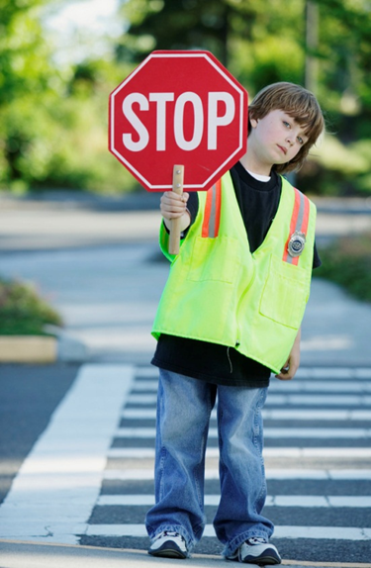
Occupational Health and Safety
Council is committed to providing a safe and healthy workplace for all and we ask that you accept your responsibility to work safely, commonly known as your Duty of Care.
A Duty of Care means that you must:
Comply with any reasonable instructions
Follow correct procedures when you are undertaking your job
Not put your fellow workers or the public at risk
Work safely
Wear Personal Protective Equipment (PPE) where and when it is required
Report anything that you may feel is unsafe.

Slide 11
Smoking, Drugs and Alcohol
The South Gippsland Shire Council is committed to providing and maintaining a safe and healthy working environment which is free from drugs and alcohol.
It is the expectation of Council that all staff and volunteers present themselves fit for work.
Volunteers and staff undertaking community transport or bus duties will have a zero drug and zero alcohol content, and will liaise with the treating health practitioner or pharmacist when being prescribed medications, to ensure compliance with this clause.
Inappropriate or unlawful use of drugs and alcohol is not permitted.
South Gippsland Shire supports a smoke free workplace. Smoking is not permitted in Council offices, buildings and vehicles.

Slide 12
Insurance and Risk Management
South Gippsland Shire Council’s insurance policy covers you while you are acting within scope of your duties for and on behalf of Council.
Your personal items are not covered by Council’s insurance.
If you use your own vehicle to perform duties you need to have current personal car insurance and it is part of the formalities that evidence of this be provided.
We are unable to cover or compensate you for any damage incurred to your own or another party’s vehicle.
Refer : Insurance Matrix in your Induction Booklet

Slide 13
Privacy
IT’S PRIVATE!
Do not share those phone numbers unless you have the permission of the individual. Ask the person requesting the information if you can give their details to the staff member or volunteer
Council will take all reasonable care to protect personal information from misuse, loss, unauthorised access, modification or disclosure according to the Information Privacy Act 2000 and the Health Records Act 2001.

Slide 14
Gifts
Sometimes during your volunteering, people may offer you gifts as a way of showing appreciation for your contribution. Do not seek or accept gifts from people where the receipt of the gift is likely to create a conflict with your duty. Gifts or donations received by volunteers, as a result of undertaking Council business, must be declared on a register.
A gift is anything given e.g. a present, a donation, a non-monetary gift or service of a value of $50.00 or greater.

Slide 15
Fraud and Corruption
Fraud or theft is rare but when they occur it effects everyone.
Fraud is the dishonest activity causing actual or potential financial loss to any person or entity including the theft of moneys or other property by employees or persons external to the entity and where deception is used. It also includes the theft of property belonging to an entity.
Examples of fraud include:
Unauthorised removal of equipment, parts, software and office supplies from Council premises
Damage, destruction or falsification of documents
Misrepresentation of qualifications
Consider this:
If an employee prints their colour photo/funny image ($1 per A4 sheet) once a week = $52 p/a and every one of the 300 staff do the same = $15,600 p/a

Slide 16
Protected Disclosure
The Protected Disclosures Act exists to
encourage and facilitate disclosures of improper conduct by public officers and bodies while providing protection to those who make disclosures under the legislation.
You can report improper conduct to;
Chief Executive Officer, South Gippsland Shire Council
Manager People and Culture, South Gippsland Shire Council
Victorian Ombudsman on 9613 6222

Slide 17
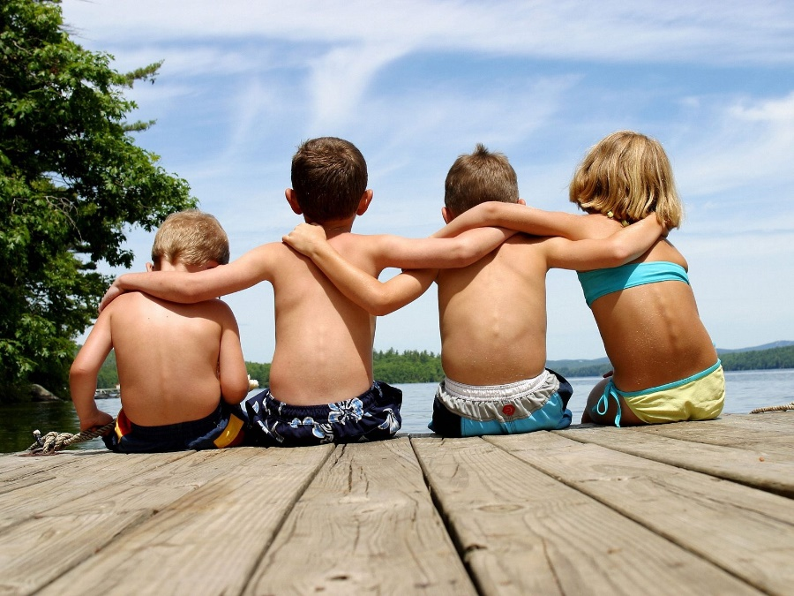
Child Safe Culture
Child Safe
Council has a moral and legal responsibility to ensure that all children and young people are safe in our direct care and supervision. Your supervisor will review the policy with you.
In summary
Conduct work accordingly to the requirements of the South Gippsland Shire Council Child Safe Policy, procedures and Code of Conduct.
•Be aware of the Council’s legal and moral obligations.
Report or discuss all concerns regarding child safety or harm to the Child Safety Officer (People & Culture have details of Child Safety Officer/s).
•Where a child is in immediate danger call 000.

Slide 18
Child Safe Culture
ANY person who believes, on reasonable grounds, that a child is in need of protection may report their concerns.
You do not have to prove that abuse has taken place. You only need reasonable grounds for your belief.
You do not need permission from parents or caregivers to make a notification; nor do they need to be informed that a notification is being made.
If you make a notification in good faith, you cannot be held legally liable - regardless of the outcome of the notification.
Your identity will remain confidential unless you need to give evidence if the matter goes to court.

Slide 19
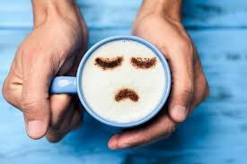
Does the Role Fit
The Right Role Sometimes a role will not suit you, if this occurs please discuss this with your supervisor.
Resignation If you choose to resign please give as much notice as possible.
Discontinuation of Service If this occurs it could follow, for example, instances of a volunteer behaving in a that is harmful or contrary to Council policies.
Exit Interview We will offer you an exit interview to capture your feedback about your volunteer experience

Slide 20
Time to Finish Volunteering
Resignation
We understand that your circumstances and preferences may change and you may decide to leave. If this occurs it is preferable that you give as much notice as possible to allow your supervisor to find someone to take over your duties.
Because we value your contribution and feedback, we would like to complete an Exit Interview with you. This will provide valuable feedback and help us in supporting volunteers in the future.

Slide 21
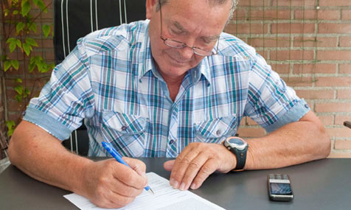
Time to Finish Volunteering
Discontinuation of Service
In rare cases there may be a need to discontinue the services of a volunteer. For example, instances of a volunteer behaving in a dangerous manner that is harmful or contrary to Council policies, or is a risk to community, personal safety or a serious breach of the law.
If you disagree with the discontinuation you have access to a grievance resolution process. If you have any questions ask your supervisor.

Slide 22
Grievance Process

Slide 23
Thank You
To finish …
Thank you for partnering with Council to deliver services to the community that make it richer, stronger and more equitable.
We hope you enjoy your time as a volunteer.
Please click here to answer a 7 questions https://form.jotform.com/193490611295865

